Slide 1

Sprocket Central Pty Ltd
Data analytics approach
[Division Name] - [Engagement Manager], [Senior Consultant], [Junior Consultant]

Slide 2
Agenda
Introduction
Data Exploration
Model Development
Interpretation

Slide 3
Introduction
Analysis
Age distributions by gender
Number of bike purchases in 3 years / percentages purchases according to gender
No of cars V/s State
No of persons v/s Industry type
No of persons v/s Product Type
Wealth segments
No of cycles sold v/s Brand Type

Slide 4
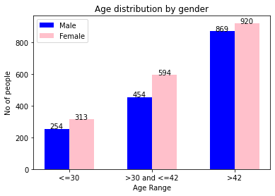
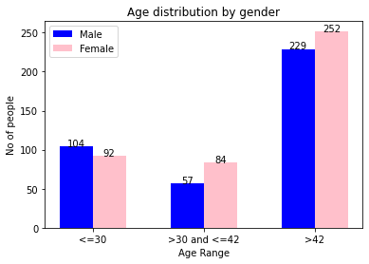
Data Exploration
OLD DATA
Age Distribution by gender
Majority of the customers fall in the >42 years category.
Also in >42 year category , majority of them are female.
NEW DATA
In new data also,
Majority of the customers fall in the >42 years category.
Also in >42 year category , majority of them are female.

Slide 5
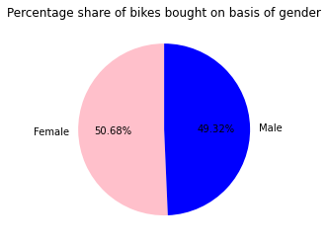
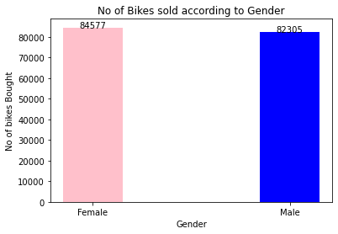
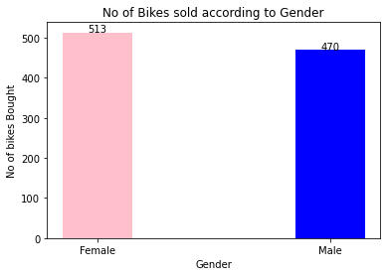
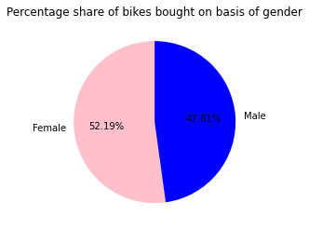
Model Development
OLD DATA
Bike Purchases according to gender
According to the data provided,
The bikes were bought majorly by women with over 50.68%.
The distribution shows that in every age range, women bought
higher no of bikes as compared to men.
NEW DATA
In the new data , the share of women is still
greater than men.
Strategy to increase more sales-
Women-centric advertisements can be made to drive sales.

Slide 6
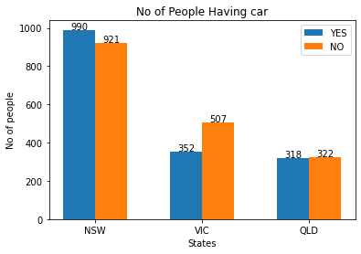
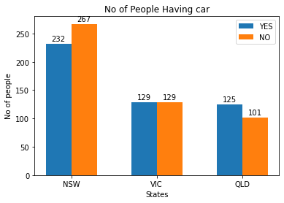
Interpretation
No of cars V/s States
OLD DATA
According to the data, the number of people not owning car in VIC share a higher percentage as compared to other states. Therefore VIC has a huge potential in terms of sales of bikes.
NEW DATA
According to the new data, the number of people not owning car in NSW outweigh the number of people than other states. Therefore NSW has a huge potential in terms of sales of bikes.

Slide 7
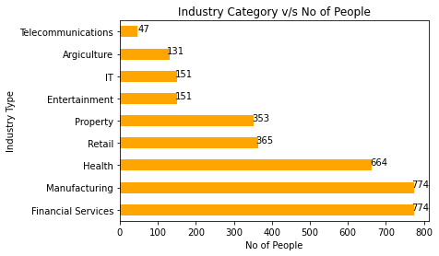
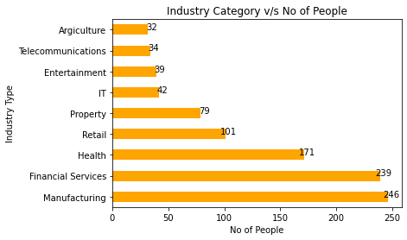
Interpretation
No of persons v/s Industry type
OLD DATA
According to the data , majority of the people work in the Manufacturing sector & Financial Sector. So there is a good potential of selling the bikes to the these type of people.
According to the new data , majority of the people work in the Financial sector & Manufacturing sector. So there is a good potential of selling the bikes to the these type of people.
NEW DATA

Slide 8
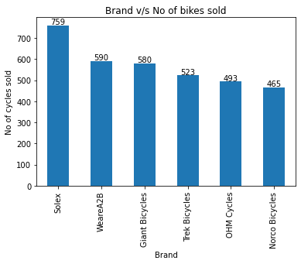
Interpretation
No of bikes sold v/s Brand Type
According to the data , the highest selling bikes brand is Solex. Other brands sold almost equal number of bikes.
More focus to Solex to promote more sales and change strategy for other brands to boost sales and identify weakness.

Slide 9
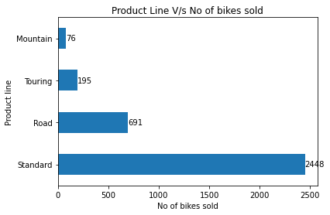
Interpretation
No of persons v/s Product Type
Also the no of bikes sold in Standard product line is the maximum.
This means that Standard product line should be marketed more to drive sales.

Slide 10
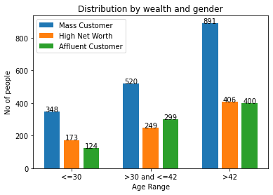
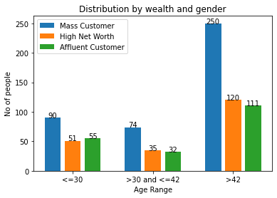
Interpretation
Distribution by wealth segment and age
OLD DATA
From the graph we can interpret that, the highest number of people fall in the over 42 years age and mass customer category.
NEW DATA
The new data shows, the highest number of people fall in the over 42 years age and mass customer category.

Slide 11
Appendix

